Slide 1
Ethical Hacking Task 2

Slide 2
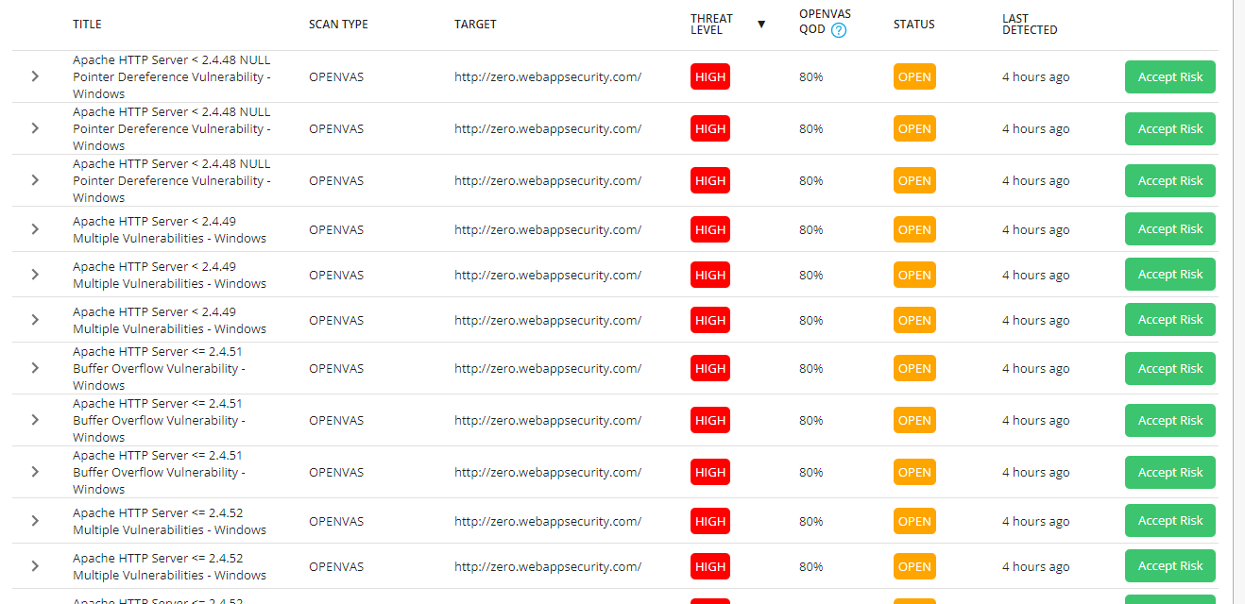
Found Vulnerabilities

Slide 3
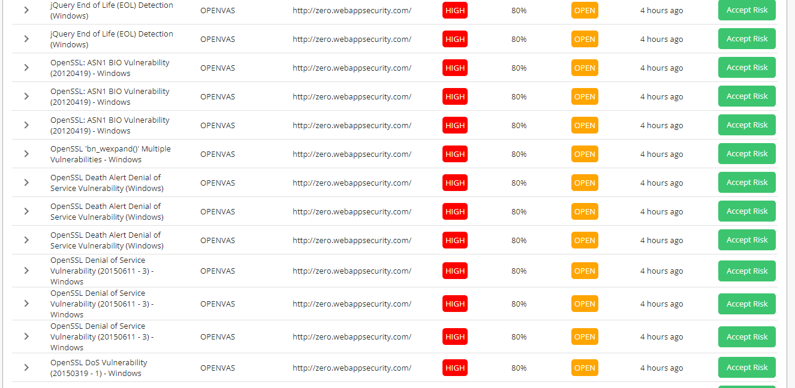
Found Vulnerabilities

Slide 4
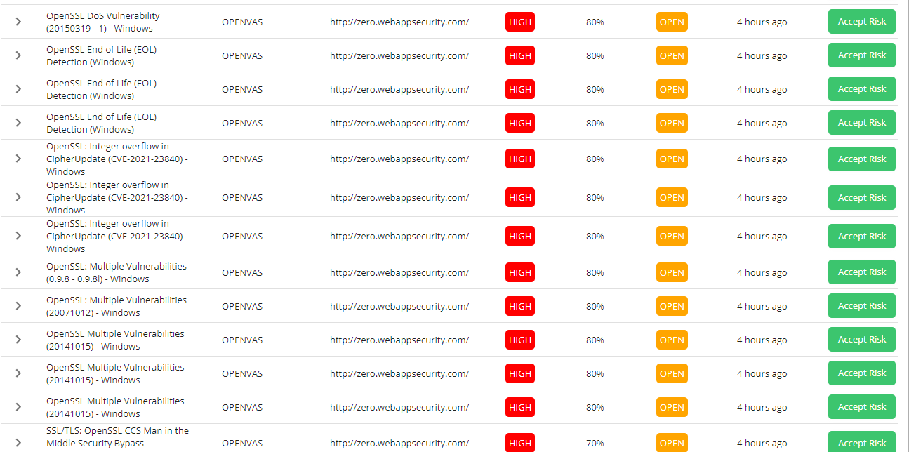
Found Vulnerabilities

Slide 5
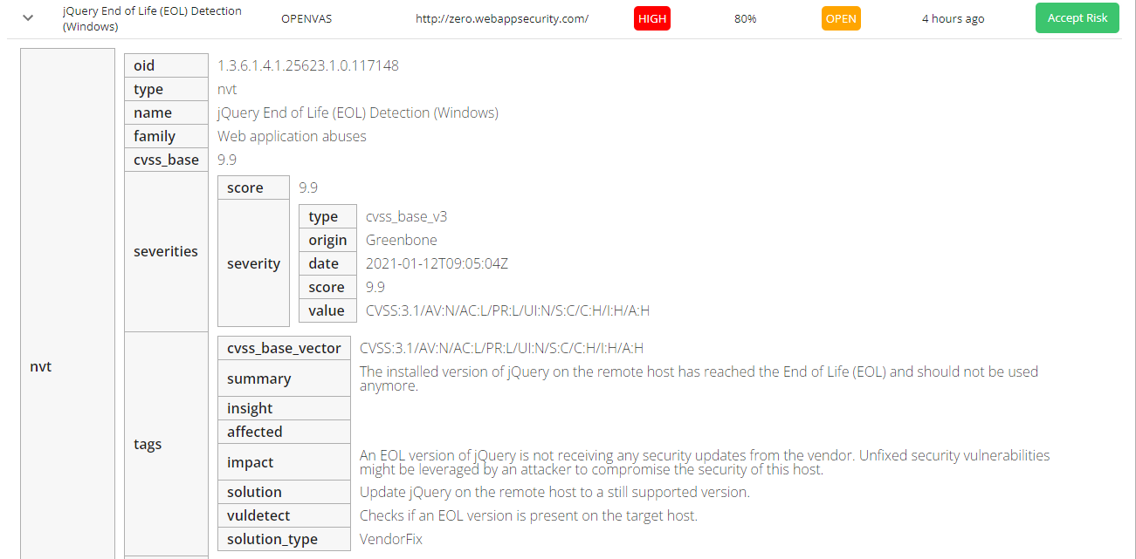
Scanner Report

Slide 6
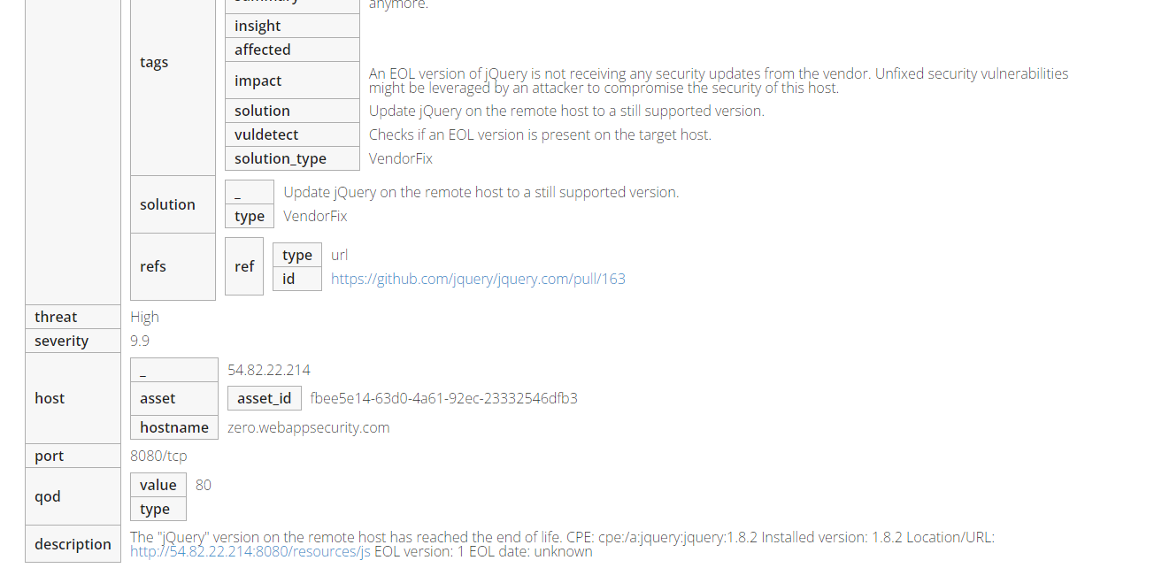
Scanner Report

Slide 7
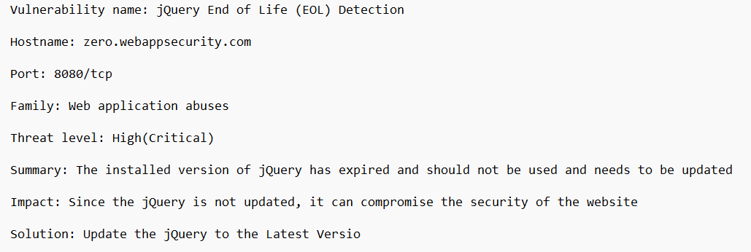
Report

